Slide 1
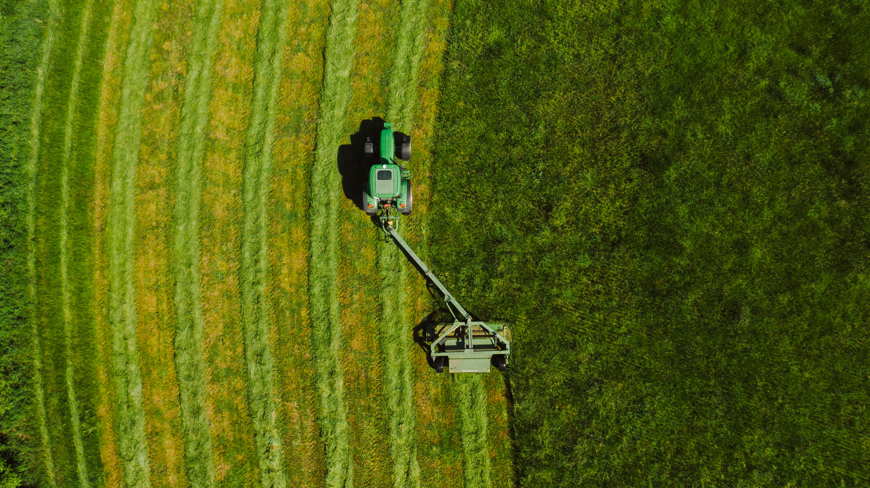
Farmer support system using AI/ML : Crop recommendation, environmental favorability prediction and disease detection using deep learning

Slide 2
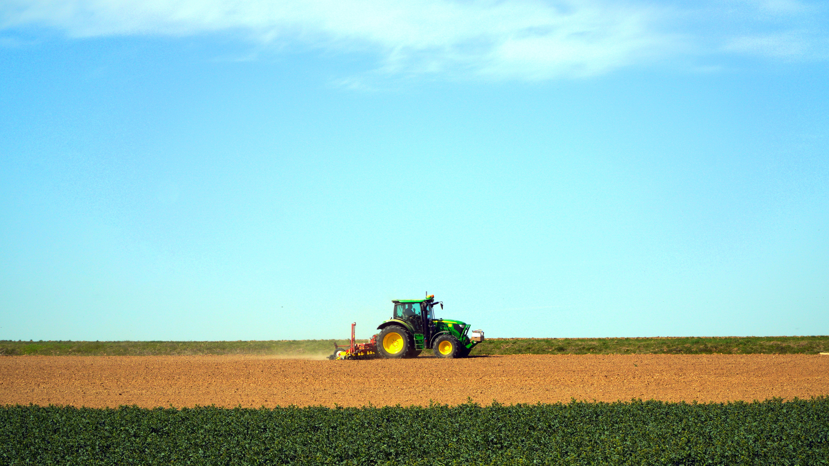
Table Content
Objective
Scope
Data Description
Methodology
Results
Future Work

Slide 3
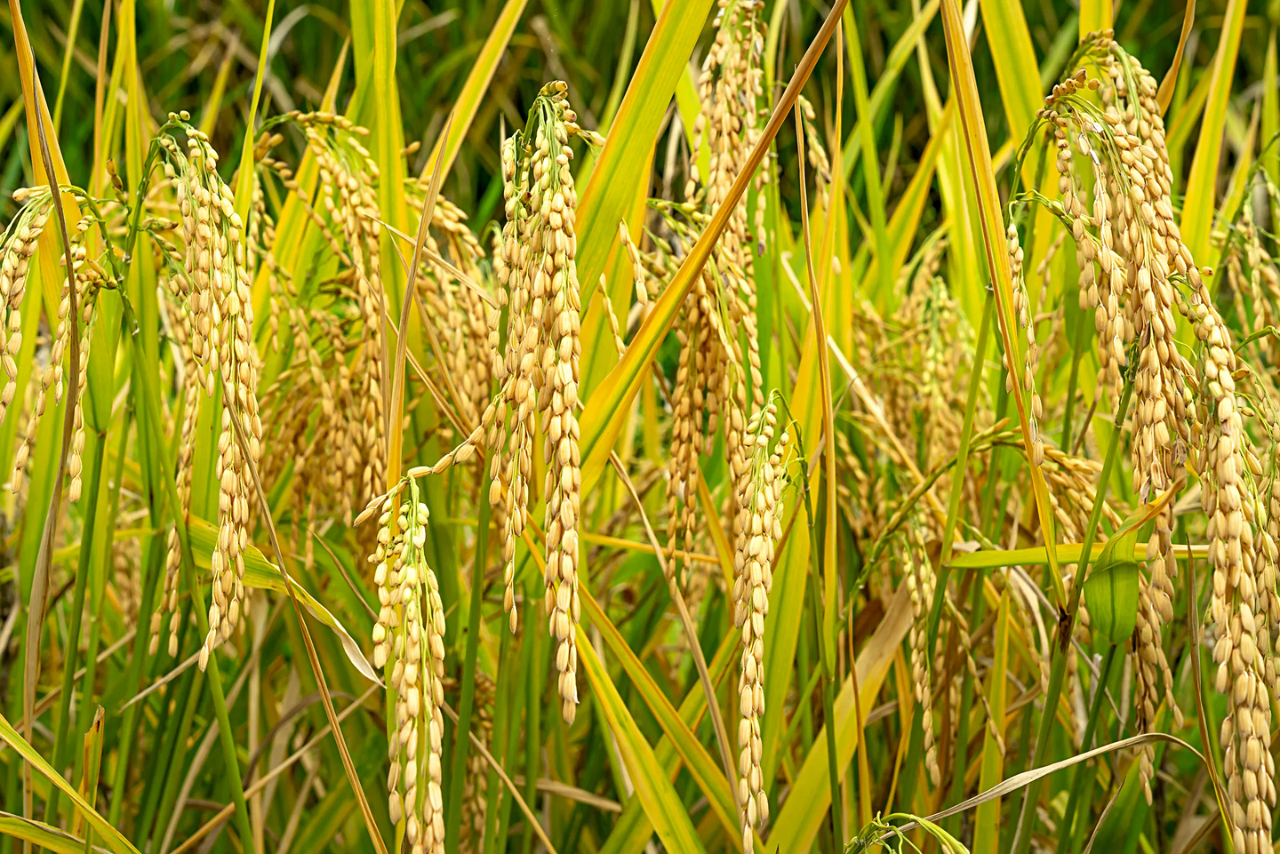
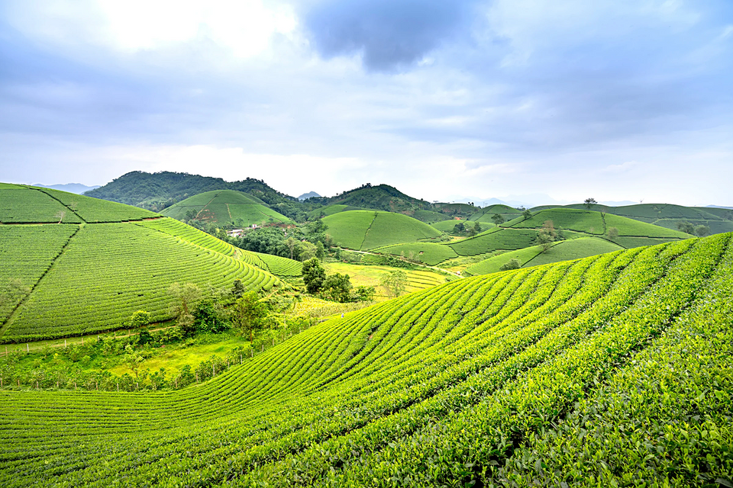
Scope
The "Farmer Support System using AI/ML" project creates an integrated platform harnessing AI and ML to aid farmers. It collects and analyzes environmental data, using ML for crop recommendations and environmental adaptability predictions, and deep learning for early disease detection from crop leaf images. The platform offers a user-friendly interface for real-time data analysis and personalized recommendations, empowering farmers with insights to optimize cultivation, enhance productivity, and promote sustainable practices.

Slide 4
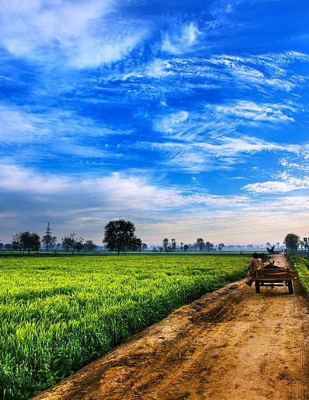
Objective
The "Farmer Support System using AI/ML" project aims to empower farmers by utilizing AI and ML technologies. It develops a decision-support system that analyzes environmental and location-specific data to recommend suitable crops. It also includes predictive analytics for crop performance forecasting and a disease detection module using deep learning algorithms for early identification of crop diseases. The project seeks to provide actionable insights to optimize crop yields, mitigate risks, and promote sustainable farming practices.

Slide 5

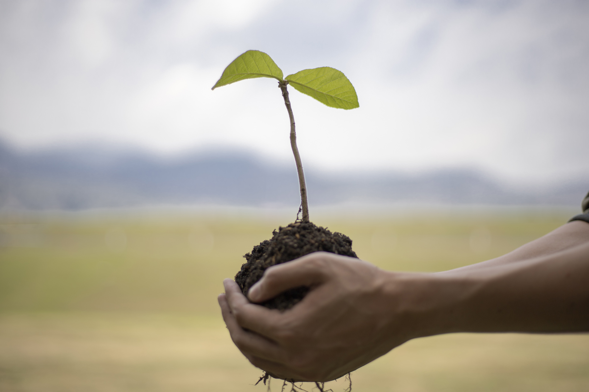
Dataset Description:
Crop Recommendation
We used Farm Futro Dataset of crop recommendation system which consist of 2212 rows and 19 columns.
Dataset Description:
Dieseases detection
We used the Crop Disease Improved Version Dataset for diseases in wheat, apple, and tea leaves, providing a comprehensive image collection for training. The MangoLeafBD Dataset was employed for mango leaf diseases, while JMuBEN and JMuBEN2 datasets were used for coffee leaf diseases, offering diverse images to enhance our model's recognition capabilities. Additionally, the Rice_disease_model dataset aided in identifying diseases in rice leaves. By combining these datasets, we developed comprehensive models proficient in identifying diseases across wheat, apple, tea, mango, coffee, and rice crops, advancing agricultural disease detection for sustainable farming practices.
04

Slide 6
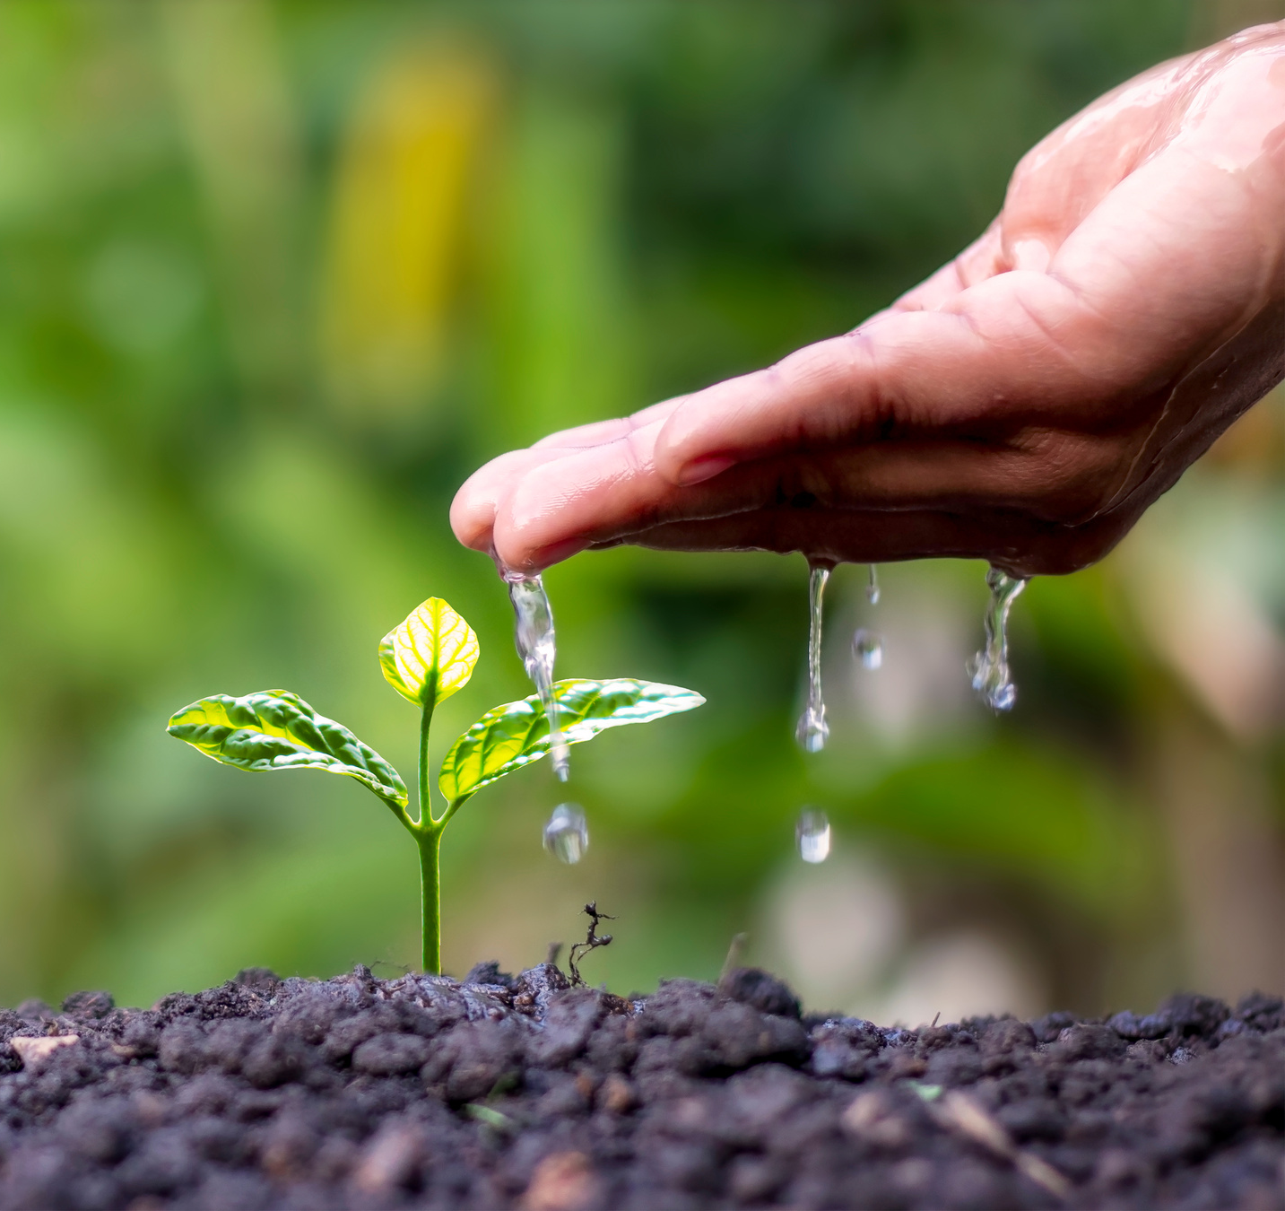

DATASET FOR CROP RECOMMENDATION
We used Farm Futro Dataset of crop recommendation system which consist of 2212 rows and 19 columns.
Temperature:This column likely represents the temperature of the environment or soil, measured in a specific unit such as Celsius or Fahrenheit.
Humidity:This column likely represents the humidity level, which is the amount of moisture present in the air or soil, usually measured in percentage.
ph:This column likely represents the humidity level, which is the amount of moisture present in the air or soil, usually measured in percentage.
rainfall This column likely represents the amount of rainfall in a specific area or region, typically measured in millimeters or inches.
Ph after harvest:This column could represent the pH level of the soil after harvesting crops, which may be different from the initial pH level.
Seasons:This column may indicate the season during which the data was collected, such as summer, winter, etc.
States:This column likely indicates the states or regions where the data was collected.
Label:This column might contain labels or categories assigned to the data, such as crop types, crop health status, etc.
Unnamed 9 to 18:These columns appear to be unnamed and might be additional data columns or possibly formatting artifacts from the dataset. They seem to be empty or contain irrelevant information.
Presentation Design

Slide 7

DATASET FOR DISEASES DETECTION
We used the Crop Disease Improved Version Dataset for diseases in wheat, apple, and tea leaves, providing a comprehensive image collection for training. The MangoLeafBD Dataset was employed for mango leaf diseases, while JMuBEN and JMuBEN2 datasets were used for coffee leaf diseases, offering diverse images to enhance our model's recognition capabilities. Additionally, the Rice_disease_model dataset aided in identifying diseases in rice leaves. By combining these datasets, we developed comprehensive models proficient in identifying diseases across wheat, apple, tea, mango, coffee, and rice crops, advancing agricultural disease detection for sustainable farming practices.
Wheat: 3354 photos
Tea: 1,926 photos
Apple: 3,299 photos
Mango:4,000 photos
Coffee: 58,549 photos
Rice: 7,420 phtos

Slide 8
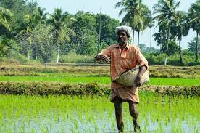
Methodology
The integrated agricultural system leverages a range of machine learning and deep learning models to support farmers comprehensively. For crop recommendation, Random Forest, Logistic Regression, SVM, and XGBoost analyze environmental factors, soil conditions, and location-specific data, delivering tailored crop suggestions for optimal cultivation practices. Concurrently, for disease detection, pre-trained CNN models like MobileNet, AlexNet, ResNet, and VGG16 identify disease patterns in crop leaf images, empowering farmers with timely insights to manage diseases and maintain crop health effectively. Together, these components enable farmers to enhance yields, mitigate risks, and promote sustainable farming practices.

Slide 9
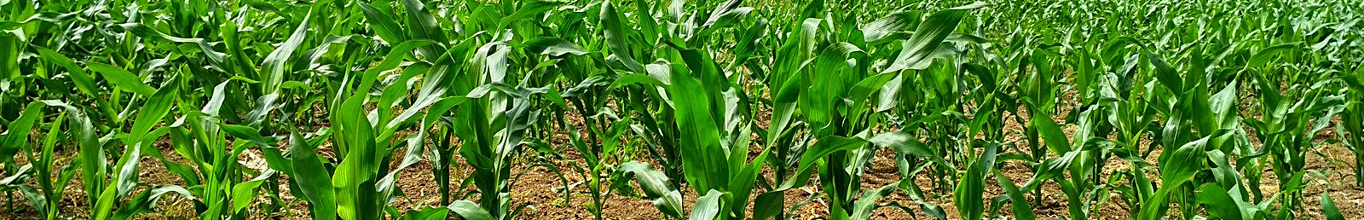
Results
Deep learning models like MobileNet and VGG16 consistently achieve high accuracy in disease detection across various crops, ranging from 94.77% to 99.98%. However, AlexNet and ResNet50 show mixed results, with accuracies varying between 46.63% and 92.38%. These findings emphasize the importance of selecting appropriate models for accurate disease detection. On the other hand, the Random Forest model achieves an impressive accuracy of 97.61%, followed closely by XGBoost with 94.50%. Logistic Regression offers reliable predictions at 86.48%, while Support Vector Machine (SVM) lags behind with an accuracy of 77.65%. Despite this, SVM remains valuable for complex data. Each model contributes uniquely to predictive analytics, catering to diverse needs in machine learning applications.

